Slide 1
The Inaugural Front End Workshop
A crash course in functional programming

Slide 2
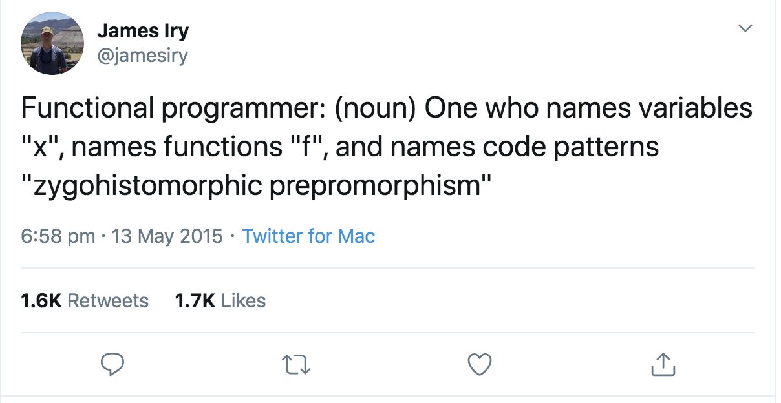
What is FP?

Slide 3
What is FP?
A programming paradigm (such as OO or procedural)
Emphasis on
Pure functions – the same arguments give the same return value, and the function doesn’t have any side effects
Immutability - create values, don’t assign them

Slide 4
Why FP?
70% of a developer’s time is spent reading code
We want to reduce mental overhead
And improve our confidence that the program will behave as expected

Slide 5
Source: https://github.com/getify/Functional-Light-JS/blob/master/manuscript/ch1.md/#chapter-1-why-functional-programming

Slide 6
Pure VS Impure functions

Slide 7
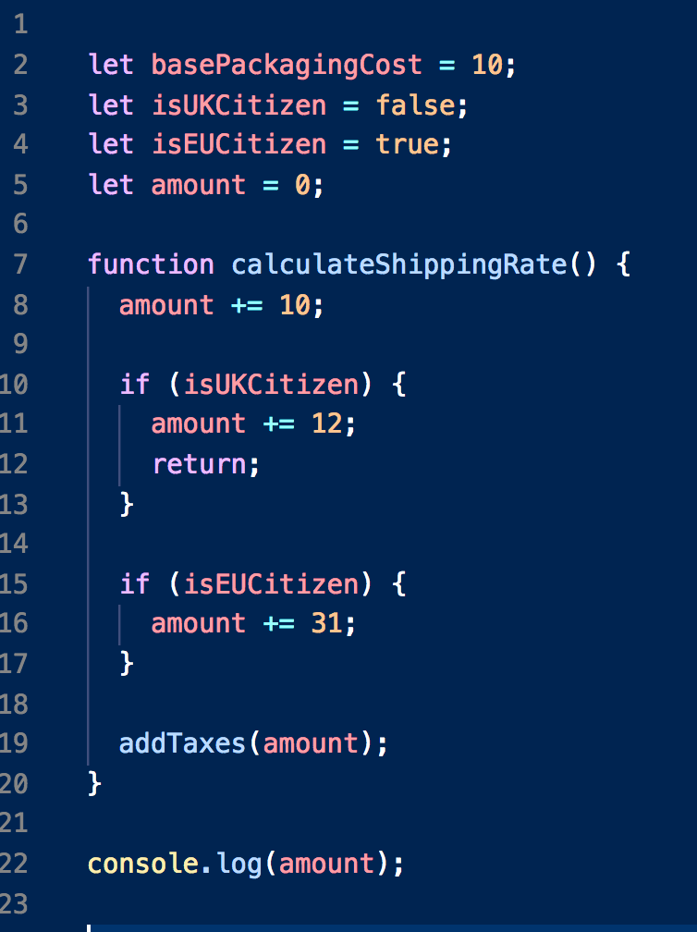
Impure
What will amount be?
Will addTaxes() mutate amount?
How can we test calculateShippingRate (mock surrounding scope?)
Hard to reason about

Slide 8
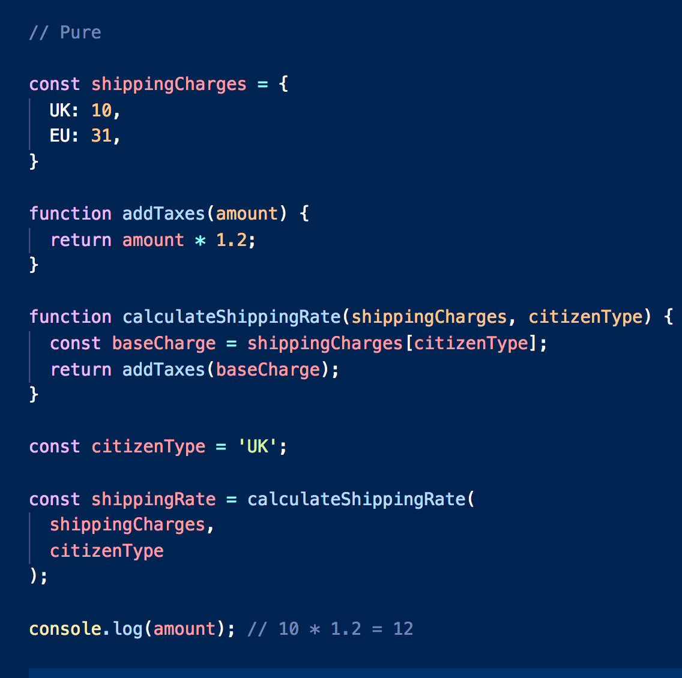
Pure
Every time you call addTaxes or calculateShippingRate with the same parameters, you get the same result
Testing is easy – call the function, assert the result
No mocking required – every value is an argument

Slide 9
Source: https://www.modernescpp.com/index.php/pure-functions

Slide 10
Tacit Programming

Slide 11
What is Tacit/Point-free Programming
A programming paradigm in which functions do not identify the arguments (or "points") on which they operate
Instead they compose other functions, and then apply the data only when the function is used

Slide 12
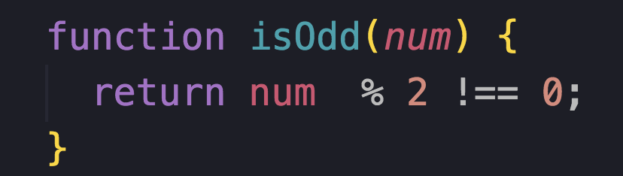
Consider:
How could we write isEven()?

Slide 13
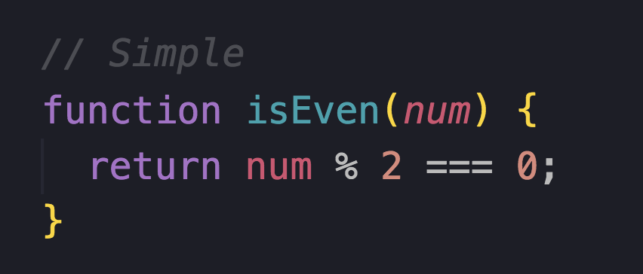
?

Slide 14
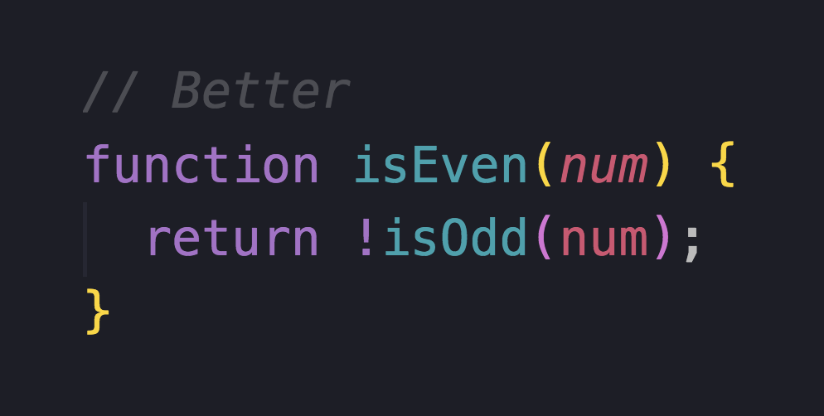
?

Slide 15
What is the intention?
We are inverting the function isOdd
Do we need a reference to the value isOdd to create this behavior?

Slide 16
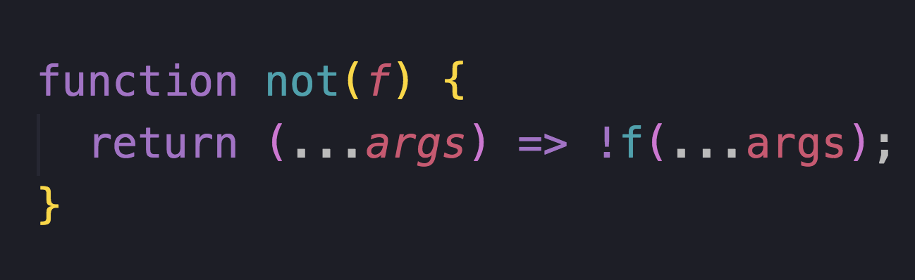
Not
Point free!

Slide 17
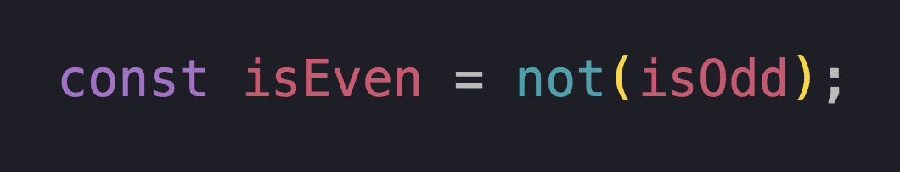
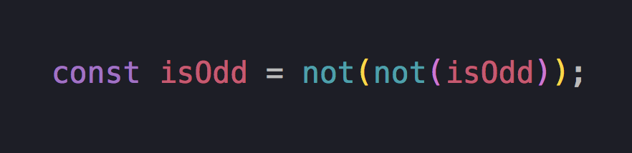

Slide 18
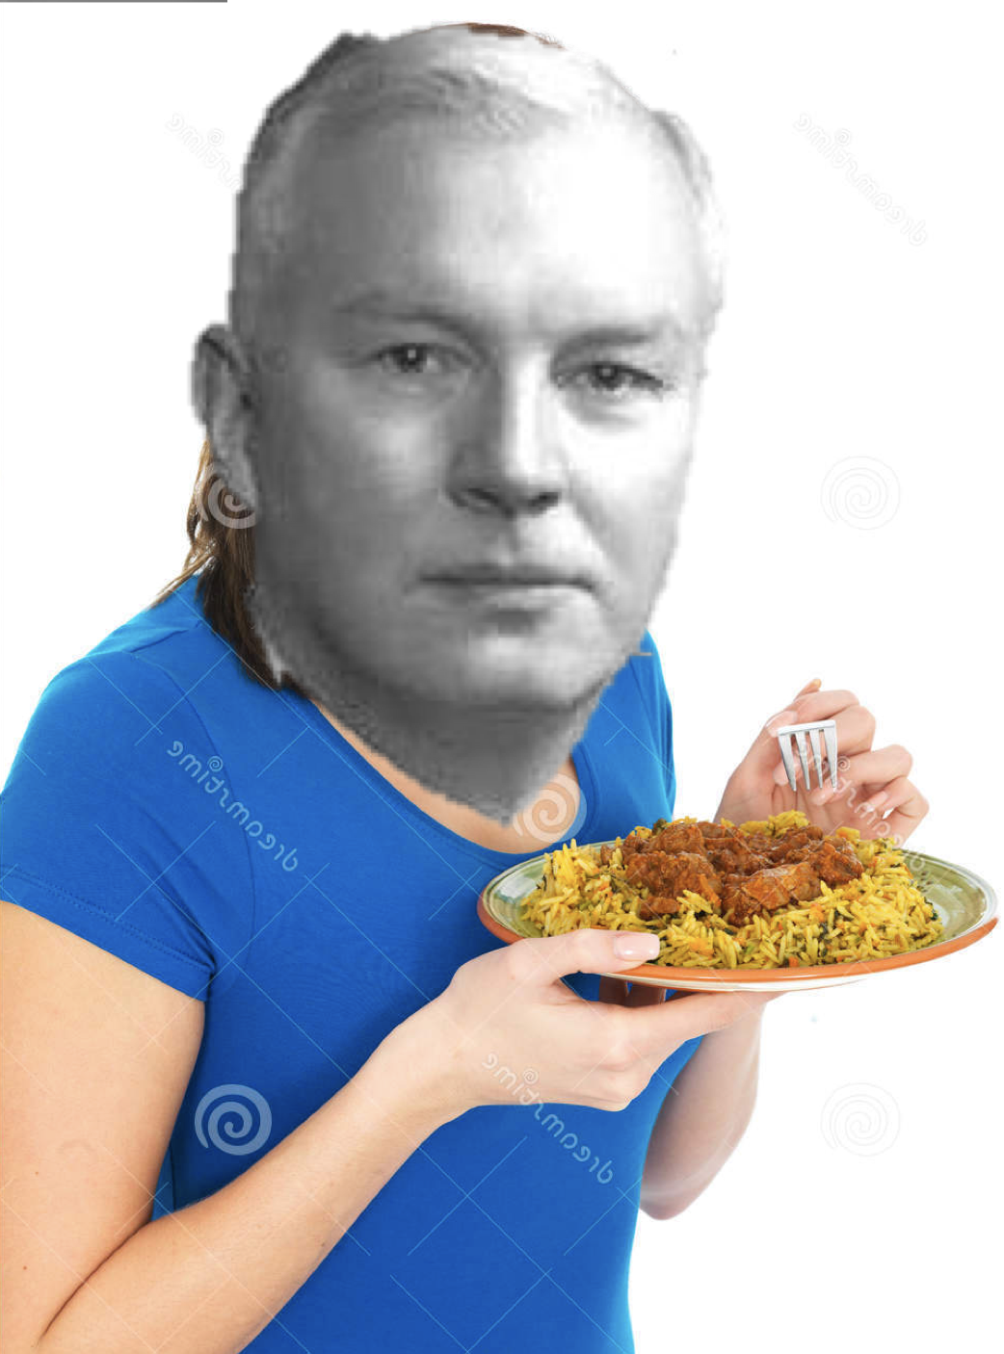
Currying
Invented by Haskell Curry
(He also invented Haskell)

Slide 19
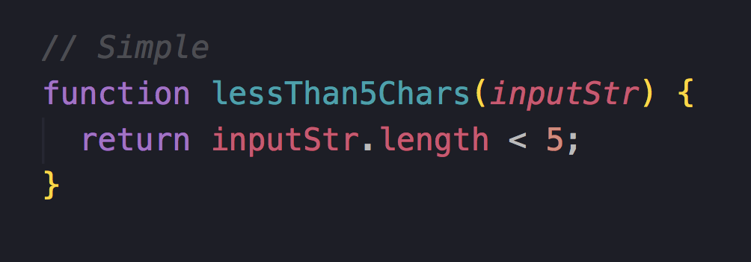
How can we make this point-free?

Slide 20
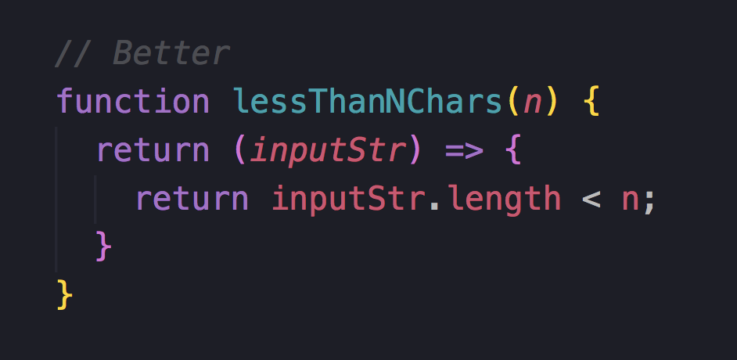
Curried
Curried functions go from f(a, b, c) -> f(a)(b)(c)

Slide 21
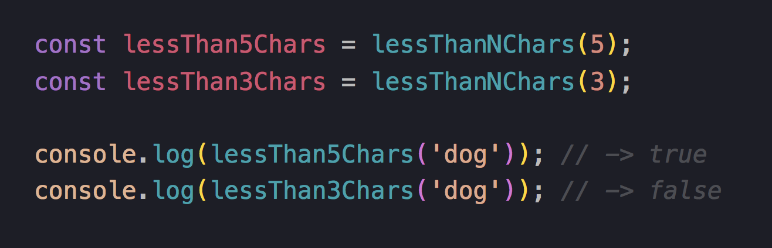
We can now apply the first argument & re-use the function

Slide 22
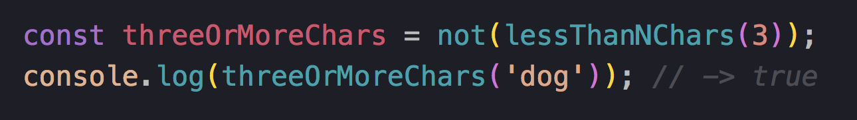
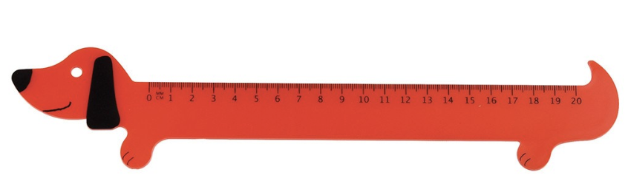
Combining these reads nicely:

Slide 23
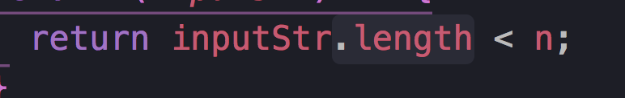
But it’s still not point free….

Slide 24
Composition

Slide 25
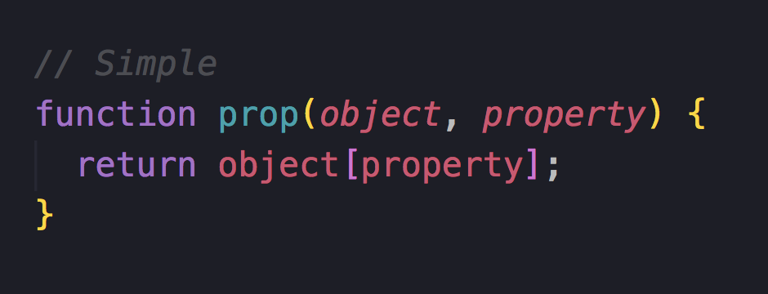

Slide 26
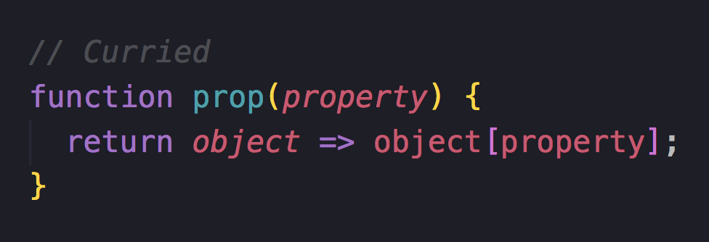
Let’s start by currying

Slide 27
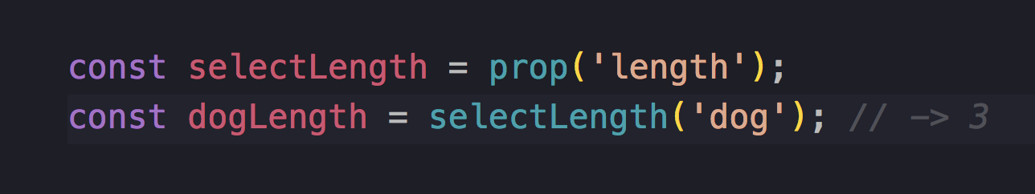


Slide 28
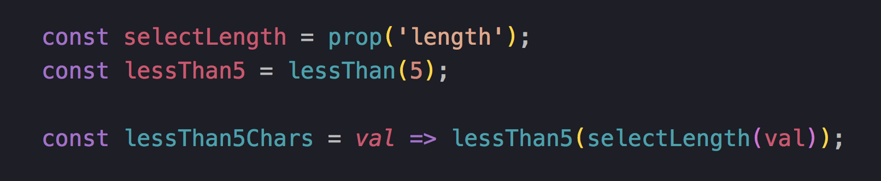
Point free!

Slide 29
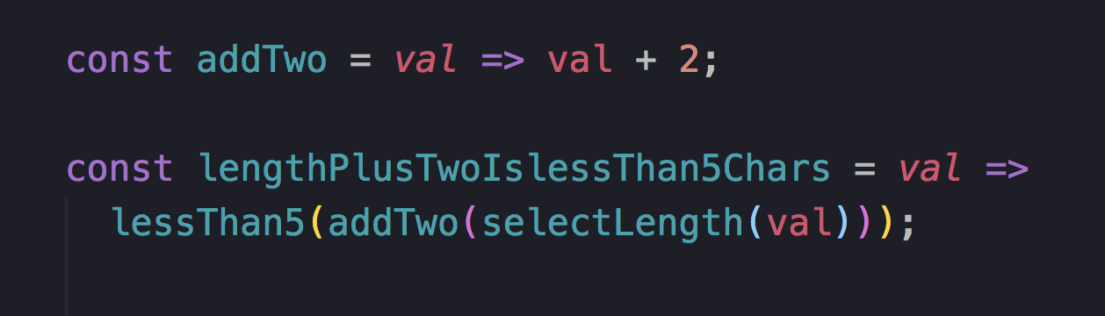
As we add functions this can get messy:

Slide 30
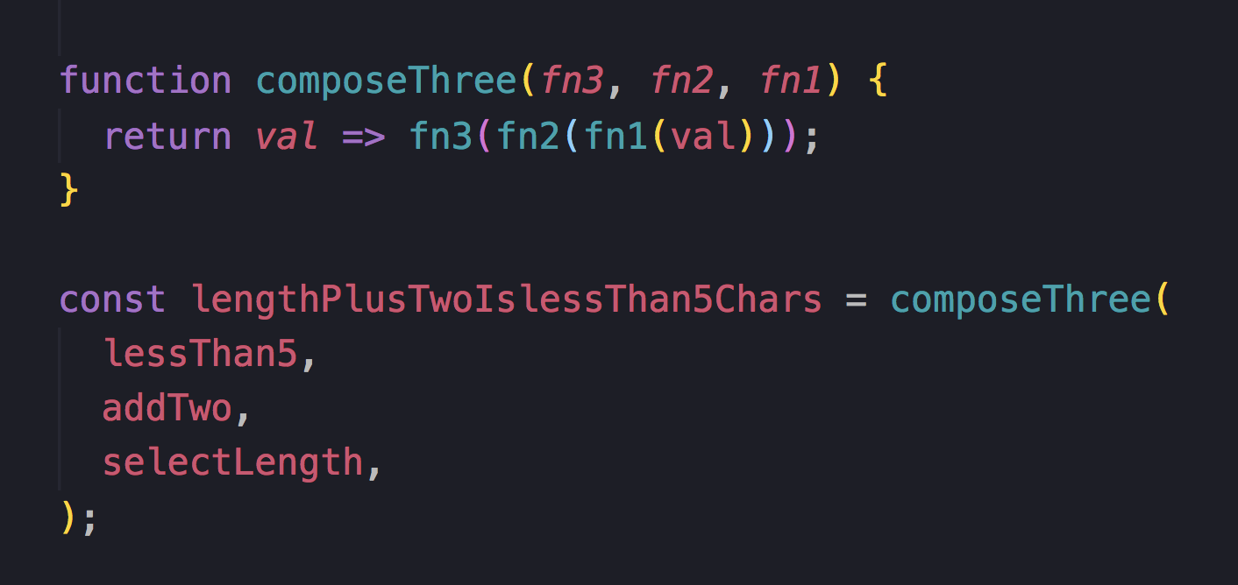
But we can compose them….

Slide 31
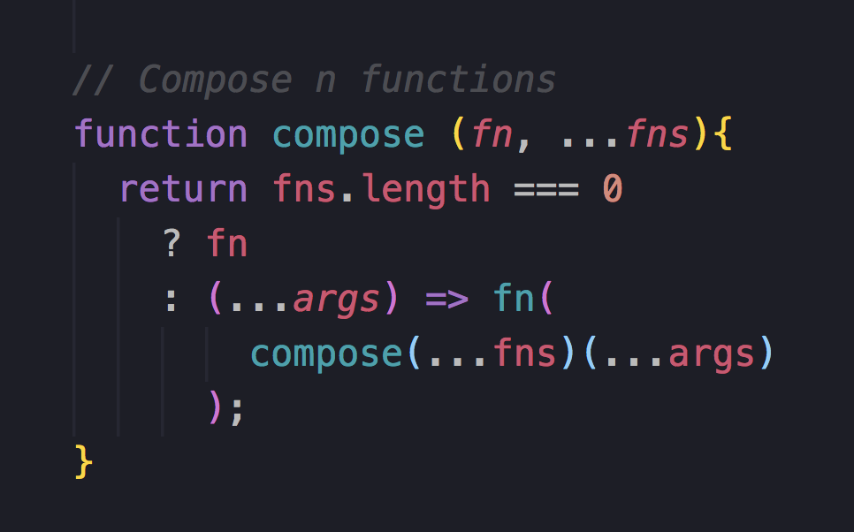
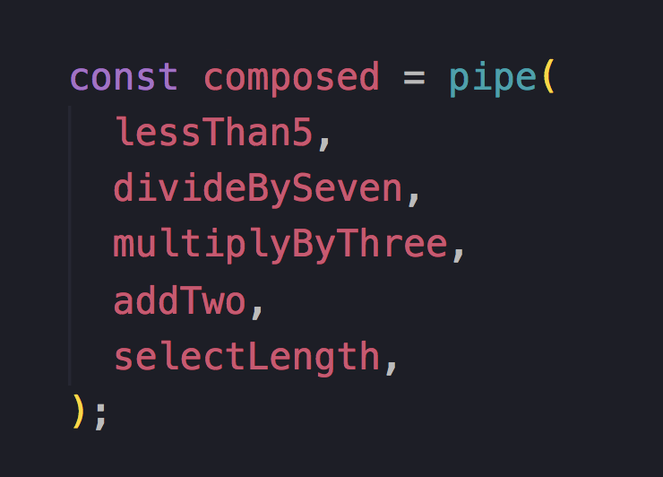
And compose n functions

Slide 32
Pipe
Compose’s less cool friend (apparently)

Slide 33
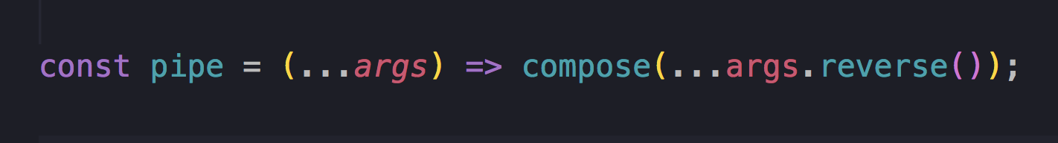

Slide 34
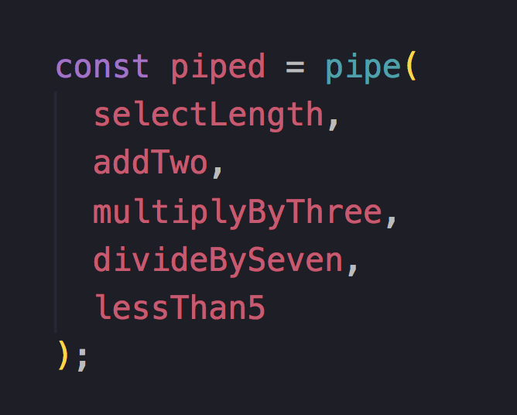
Pipe = Left-to-right
Compose = Left-to-right

Slide 35
What about the real world?
(It exists)

Slide 36
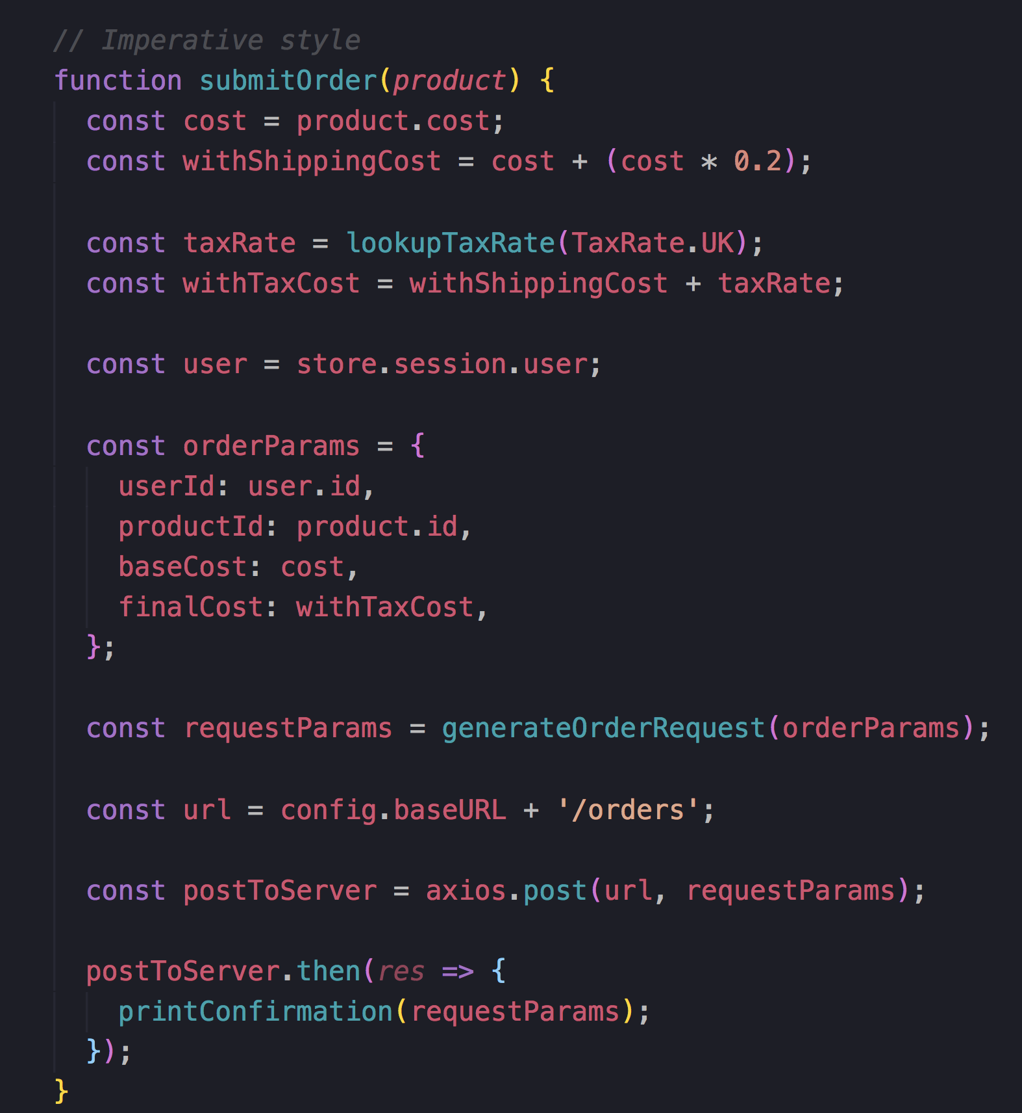


Slide 37
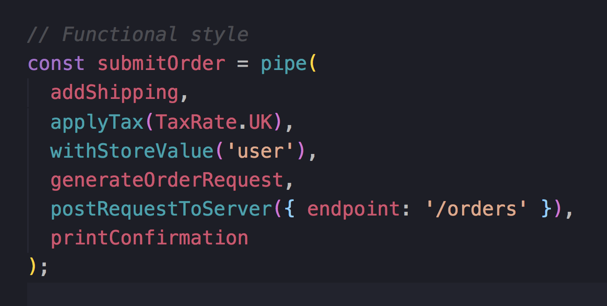
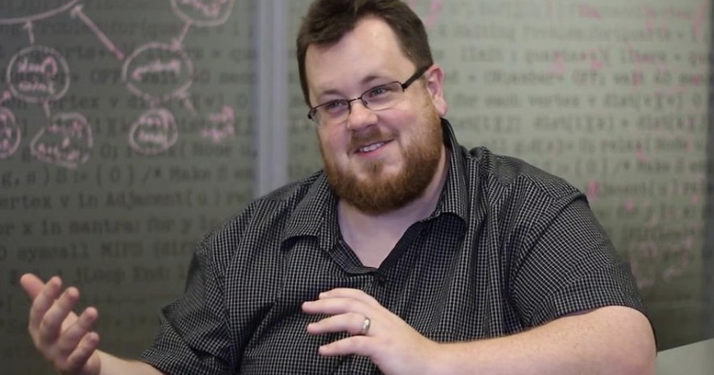
Each element re-usable
Test smaller chunks
Reads like english

Slide 38
In summary
Functions =

Slide 39
https://github.com/getify/Functional-Light-JS
Read it all for free ^

